Slide 1
얼룩말
SW structure Of ZEBTA project
어플 아이콘 사진란
미정.

Slide 2
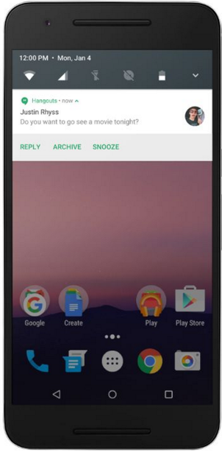
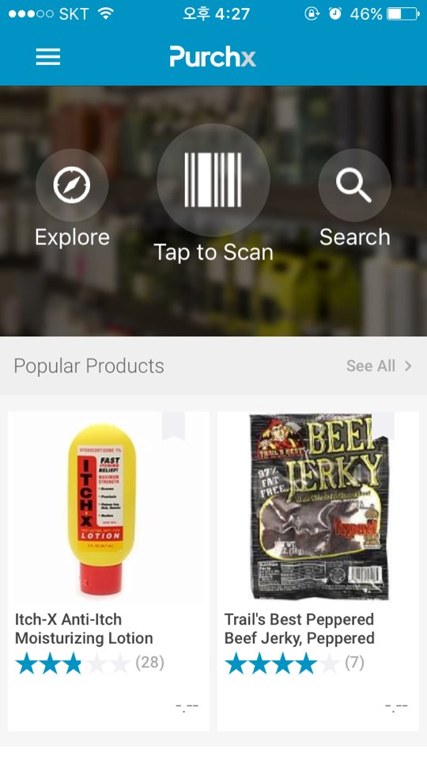
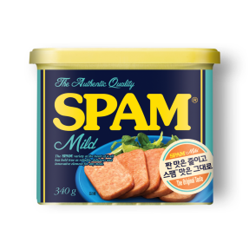

User Interface
Main Screen
Explore category
Barcode to Scan
Search
Review list
Menu bar

Slide 3







User Interface
Login Screen
E-mail
Password
Login button
Forgot Password?
Sign Up by Email >
Facebook login
Maybe Later

Slide 4





User Interface
Sign Up Screen
E-mail
Your Name
Password
Confirm Password
< Back
Privacy Policy
Terms of Service
Sign up button

Slide 5
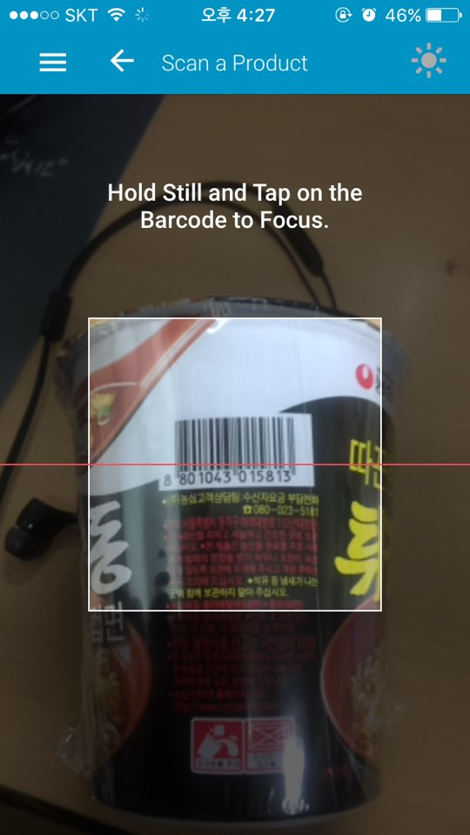
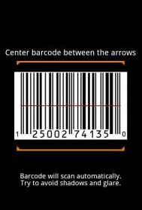
User Interface
Barcode Screen
Focus on
Barcode line

Slide 6
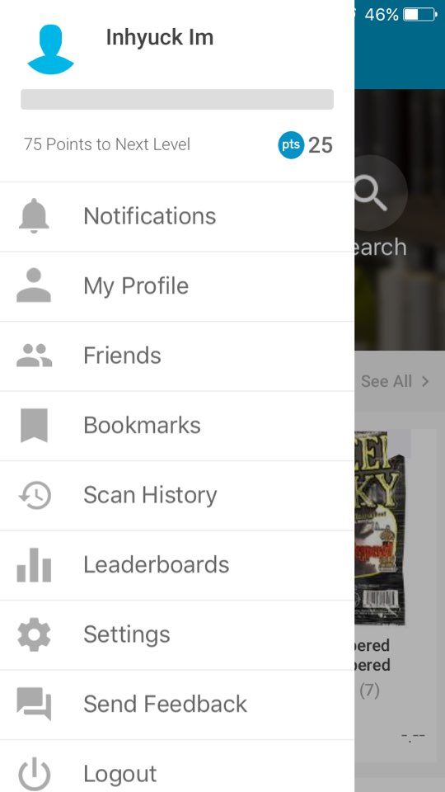



User Interface
My menu Screen
100 Points to Next Level
P 100
Notifications
My Profile
Bookmarks
Accumulated Point
Settings
Logout

Slide 7
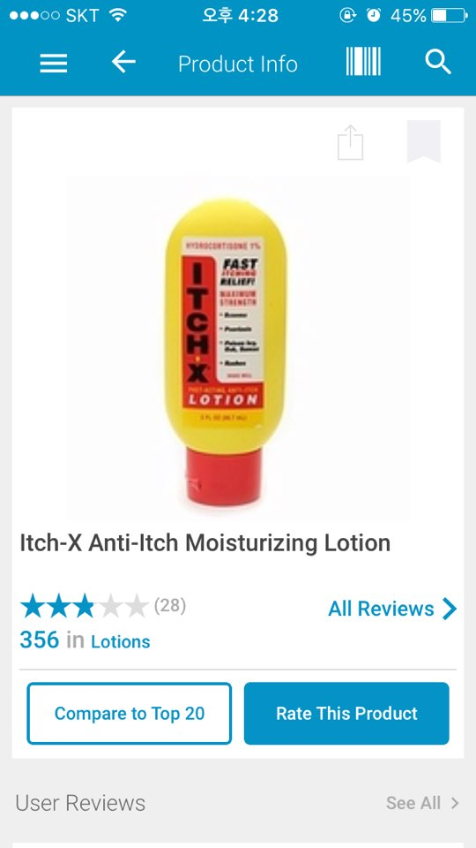

User Interface
Review Screen
Product image
Explanation of product
Rating of product
Sesame oil (Ottogi)

Slide 8
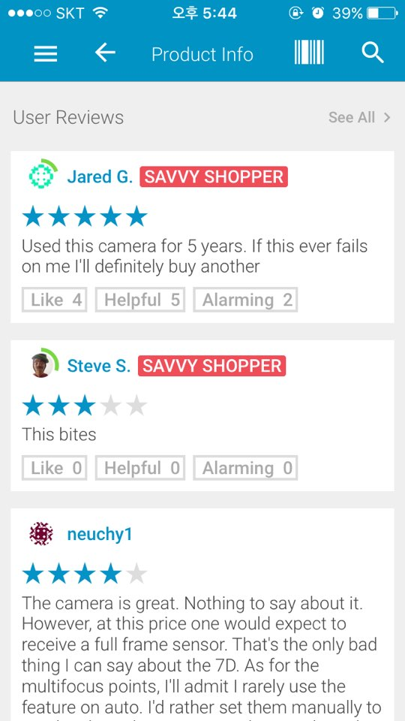
User Interface
Review Screen
Different consumer
주부
다른 참기름보다 확실히 더 고소하고 가격 대비 양이 많아요!
Review content
자취생
Like button
이거랑 계란에 밥 비벼먹으면 꿀맛
아들내미
어머니가 맨날 이 참기름만 사와요…
이제 그만 좀 사왔으면 ㅠㅠ

Slide 9
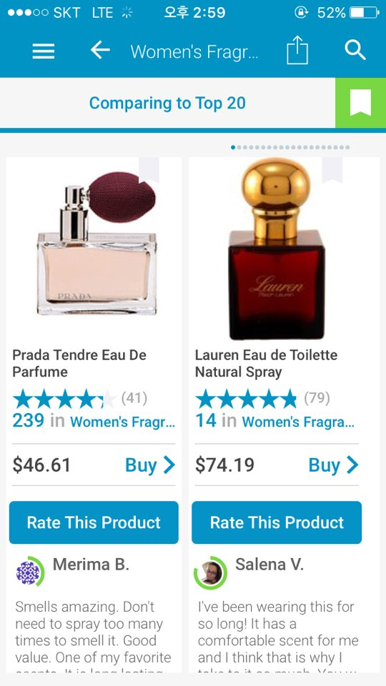




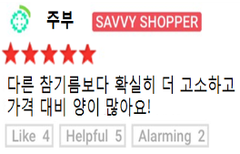
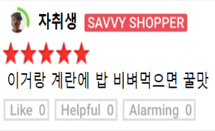
User Interface
Compare Screen
Other Product image
Review of product
샘표 참기름
해표 참기름
Rate this Product
Review
Review
Sesame oil (Ottogi)
First Review

Slide 10
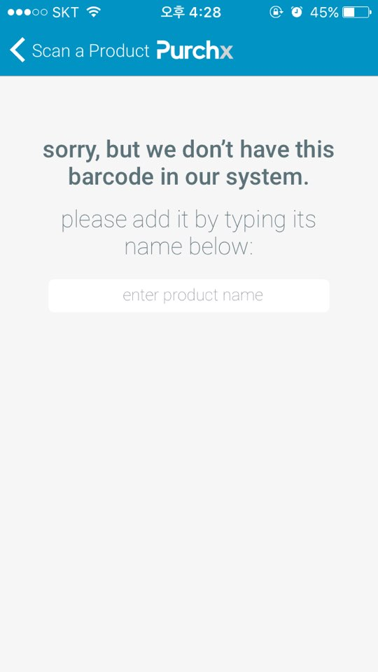
User Interface
No exist Screen
Apology statement
The first review registration
First Review

Slide 11

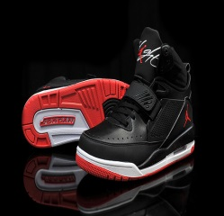

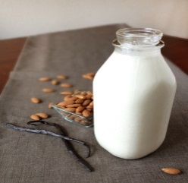



User Interface
Category Screen
Shoes
Book
Products image
Products list
Shoes
Milk
Snack
Beer
Laptop

Slide 12
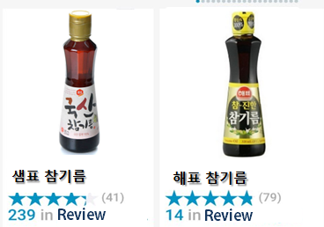
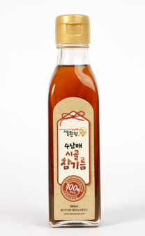

User Interface
Category Screen
TOP 1
TOP 2
Top Rank
Products list
Shoes
TOP 3
TOP 4

Slide 13
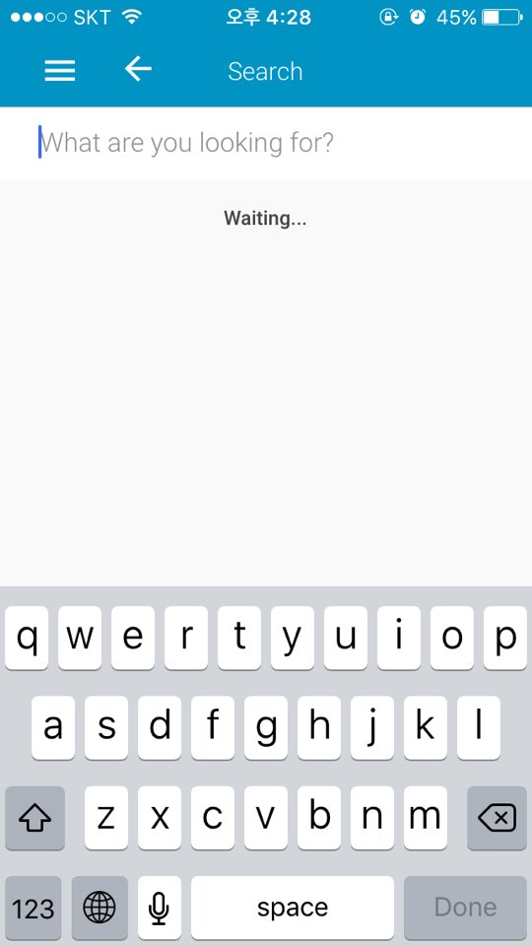
User Interface
Search Screen
Search Box
Keyboard Pop Up

Slide 14
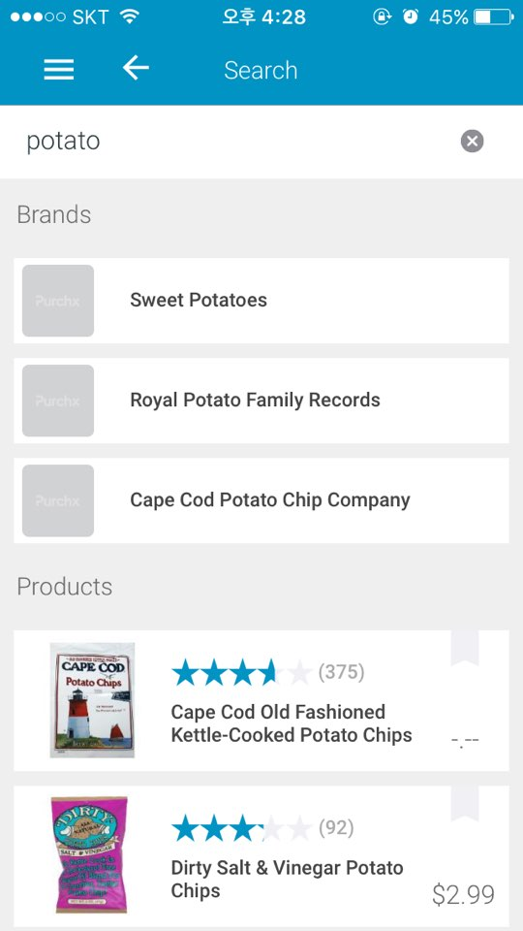





User Interface
Search Screen
짬뽕
Search Box
농심 맛짬뽕
>
Keyboard Pop Up
오뚜기 진짬뽕
>
팔도 불짬뽕
>
Search Results
Results Image
농심 신라면
삼양 불닭볶음면

Slide 15
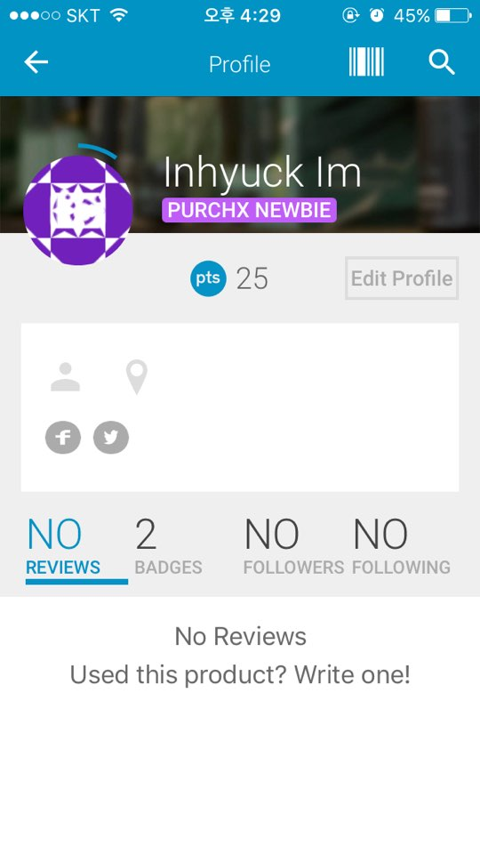



User Interface
Profile Screen
Name
Accumulated Point
Point 90,000 P
Power Shopper
Current review ranked
TOP 3.
400 500 600 900
Accumulated Reviews

Slide 16
TITLE OF PRESENTATION
THANK YOU.

